Slide 1
COT5615: Math for Intelligent Systems I
Anand Rangarajan
Lecture 5

Slide 2
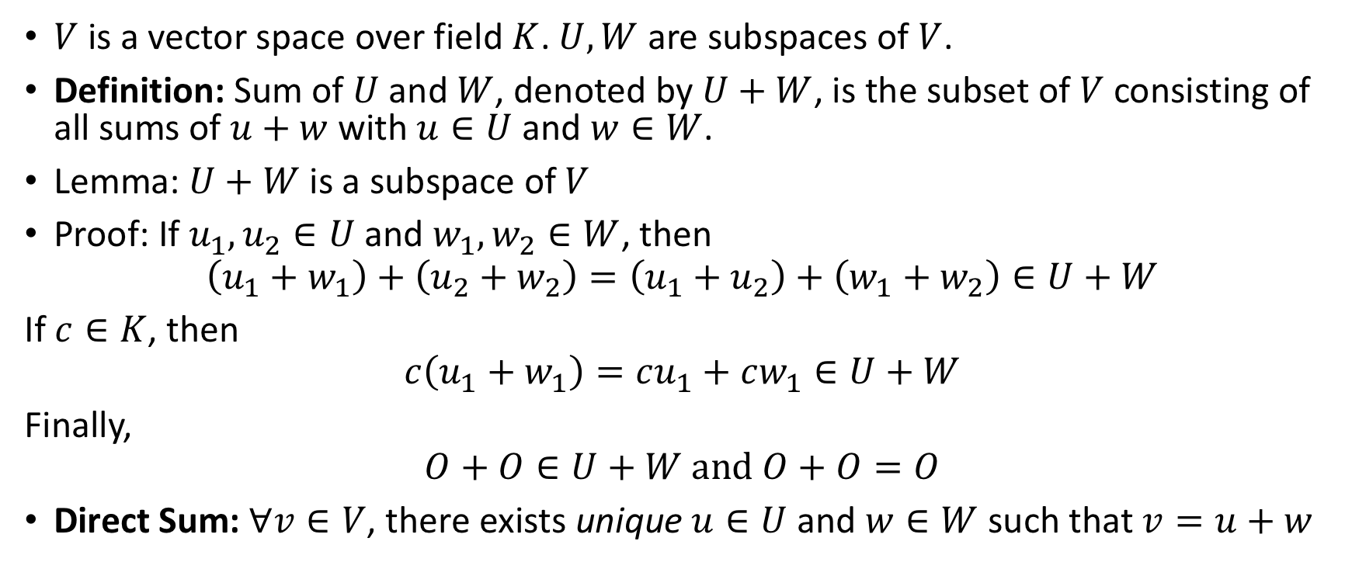
Sums and Direct Sums
$V$ is a vector space over field $K$. $U,W$ are subspaces of $V$.
Definition: Sum of $U$ and $W$, denoted by $U+W$, is the subset of $V$ consisting of all sums of $u+w$ with $u∈U$ and $w∈W$.
Lemma: $U+W$ is a subspace of $V$
Proof: If $u_{1}, u_{2}∈U$ and $w_{1},w_{2}∈W$, then
$$\left(u_{1}+w_{1}\right)+\left(u_{2}+w_{2}\right)=\left(u_{1}+u_{2}\right)+\left(w_{1}+w_{2}\right)∈U+W$$
If $c∈K$, then
$$c\left(u_{1}+w_{1}\right)=cu_{1}+cw_{1}∈U+W$$
Finally,
$$O+O∈U+W and O+O=O$$
Direct Sum: $∀v∈V$, there exists unique $u∈U$ and $w∈W$ such that $v=u+w$

Slide 3
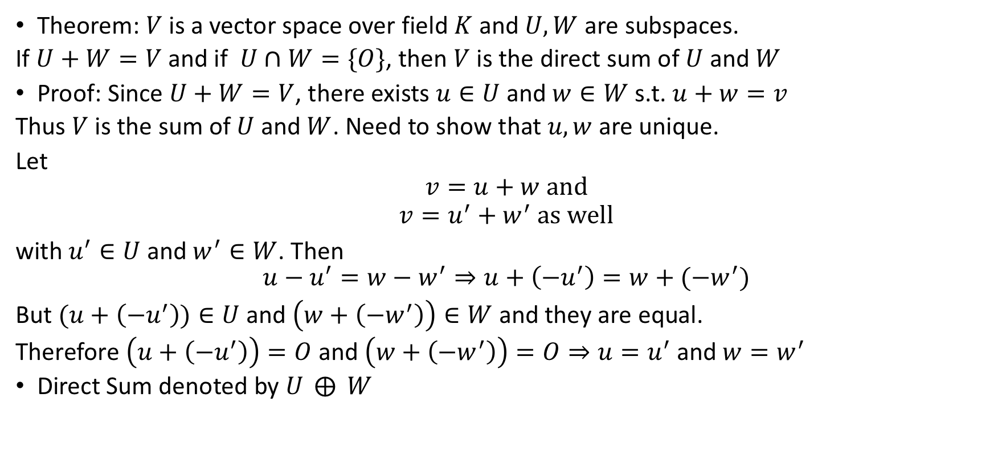
Examples of Direct Sums
Theorem: $V$ is a vector space over field $K$ and $U,W$ are subspaces.
If $U+W=V$ and if $U∩W=\{O\}$, then $V$ is the direct sum of $U$ and $W$
Proof: Since $U+W=V$, there exists $u∈U$ and $w∈W$ s.t. $u+w=v$
Thus $V$ is the sum of $U$ and $W$. Need to show that $u,w$ are unique.
Let
$$v=u+w and$$
$$v=u^{′}+w^{′} as well$$
with $u^{′}∈U$ and $w^{′}∈W$. Then
$$u−u^{′}=w−w^{′}⇒u+\left(−u^{′}\right)=w+(−w^{′})$$
But $(u+\left(−u^{′}\right))∈U$ and $\left(w+\left(−w^{′}\right)\right)∈W$ and they are equal.
Therefore $\left(u+\left(−u^{′}\right)\right)=O$ and $\left(w+\left(−w^{′}\right)\right)=O⇒u=u^{′}$ and $w=w^{′}$
Direct Sum denoted by $U ⨁{ W}$

Slide 4
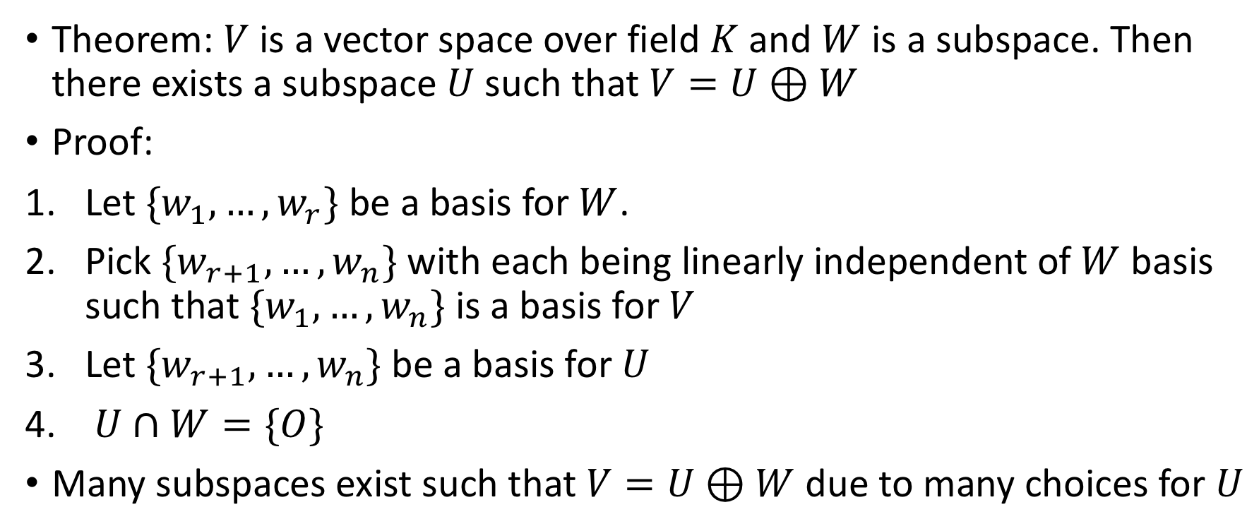
Existence of direct sum
Theorem: $V$ is a vector space over field $K$ and $W$ is a subspace. Then there exists a subspace $U$ such that $V=U⊕W$
Proof:
Let ${\{w}_{1},…,w_{r}\}$ be a basis for $W$.
Pick ${\{w}_{r+1},…,w_{n}\}$ with each being linearly independent of $W$ basis such that ${\{w}_{1},…,w_{n}\}$ is a basis for $V$
Let ${\{w}_{r+1},…,w_{n}\}$ be a basis for $U$
$U∩W=\{O\}$
Many subspaces exist such that $V=U⊕W$ due to many choices for $U$

Slide 5
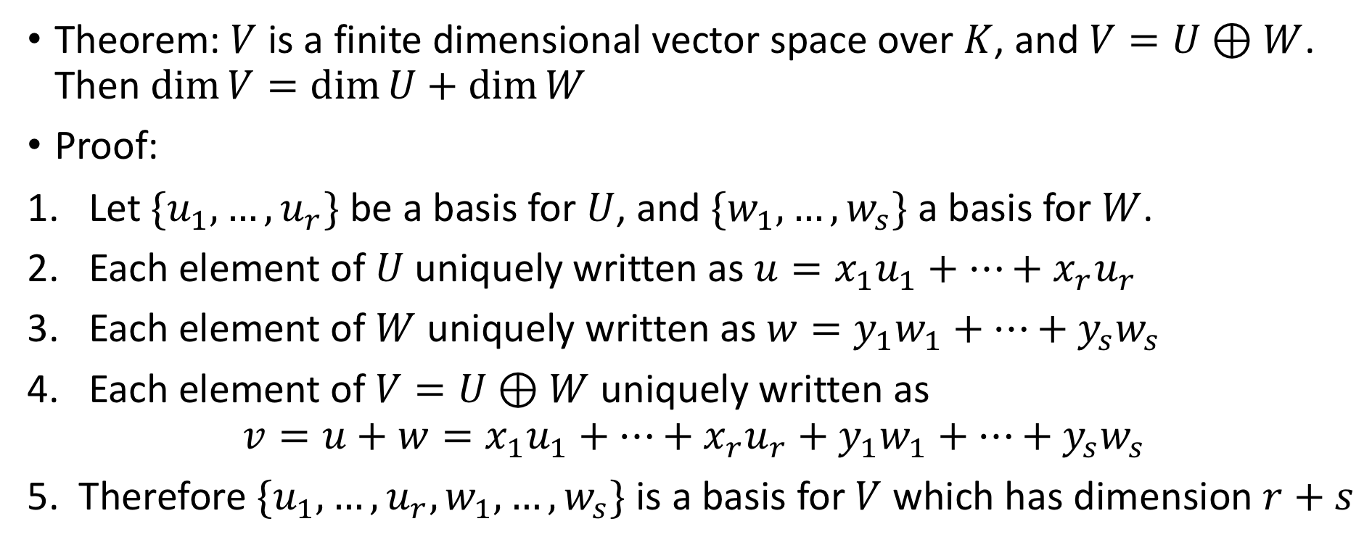
Direct Sum and Dimensions
Theorem: $V$ is a finite dimensional vector space over $K$, and $V=U⊕W$. Then $\dim{V=\dim{U+\dim{W}}}$
Proof:
Let $\{u_{1},…,u_{r}\}$ be a basis for $U$, and $\{w_{1},…,w_{s}\}$ a basis for $W$.
Each element of $U$ uniquely written as ${u=x}_{1}u_{1}+…+x_{r}u_{r}$
Each element of $W$ uniquely written as ${w=y}_{1}w_{1}+…+y_{s}w_{s}$
Each element of $V=U⊕W$ uniquely written as
$$v=u+w=x_{1}u_{1}+…+x_{r}u_{r}+y_{1}w_{1}+…+y_{s}w_{s}$$
5. Therefore $\{u_{1},…,u_{r},w_{1},…,w_{s}\}$ is a basis for $V$ which has dimension $r+s$

Slide 6
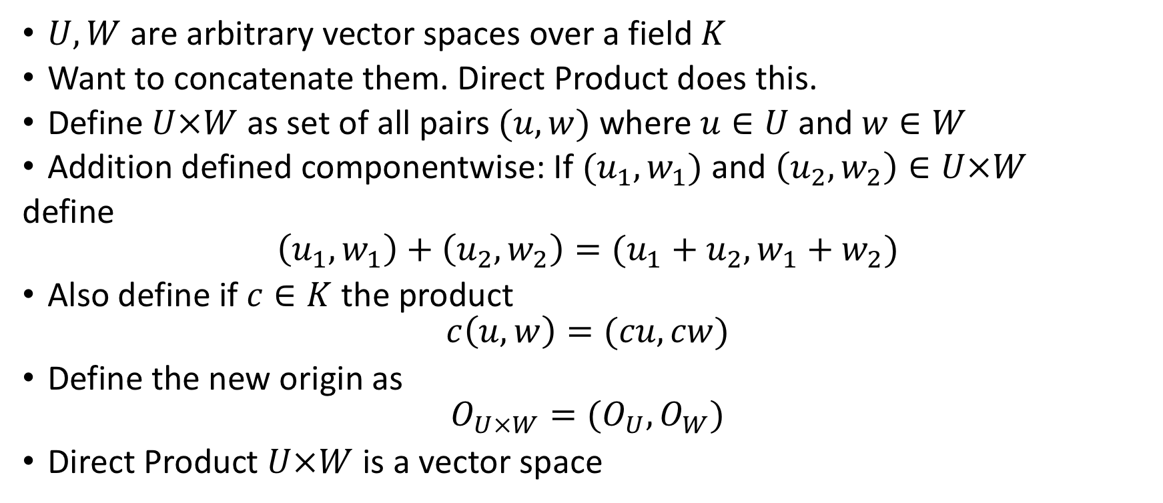
Direct Product
$U,W$ are arbitrary vector spaces over a field $K$
Want to concatenate them. Direct Product does this.
Define $U×W$ as set of all pairs $(u,w)$ where $u∈U$ and $w∈W$
Addition defined componentwise: If $(u_{1},w_{1})$ and $\left(u_{2},w_{2}\right)∈U×W$
define
$$\left(u_{1},w_{1}\right)+\left(u_{2},w_{2}\right)=(u_{1}+u_{2},w_{1}+w_{2})$$
Also define if $c∈K$ the product
$$c\left(u,w\right)=(cu,cw)$$
Define the new origin as
$$O_{U×W}=(O_{U},O_{W})$$
Direct Product $U×W$ is a vector space

Slide 7
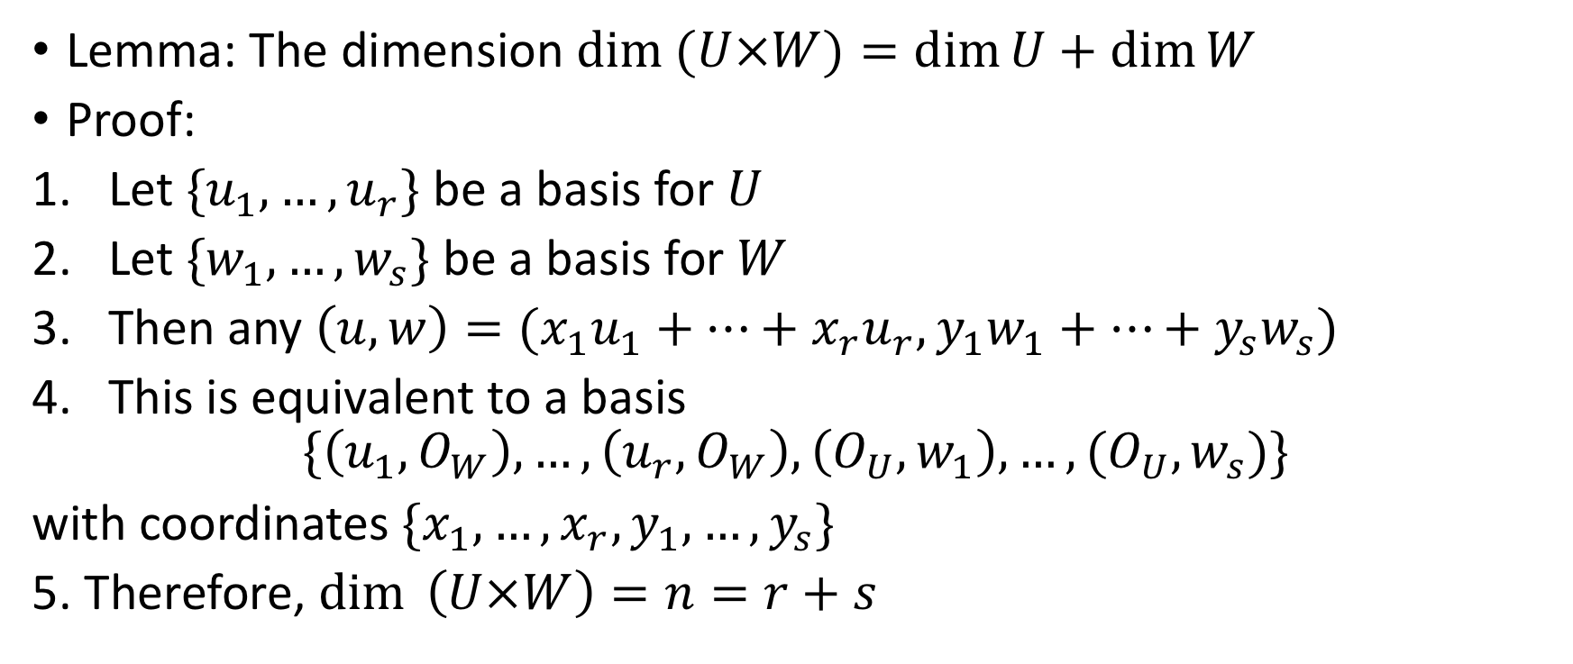
Dimension of Direct Product
Lemma: The dimension $\dim{(U×W)=\dim{U+\dim{W}}}$
Proof:
Let ${\{u}_{1},…,u_{r}\}$ be a basis for $U$
Let ${\{w}_{1},…,w_{s}\}$ be a basis for $W$
Then any $\left(u,w\right)=(x_{1}u_{1}+…+x_{r}u_{r},y_{1}w_{1}+…+y_{s}w_{s})$
This is equivalent to a basis
$$\{\left(u_{1},O_{W}\right),…,\left(u_{r},O_{W}\right),\left(O_{U},w_{1}\right),…,(O_{U},w_{s})\}$$
with coordinates $\{x_{1},…,x_{r},y_{1},…,y_{s}\}$
5. Therefore, $\dim{ \left(U×W\right)=n=r+s}$

Slide 8
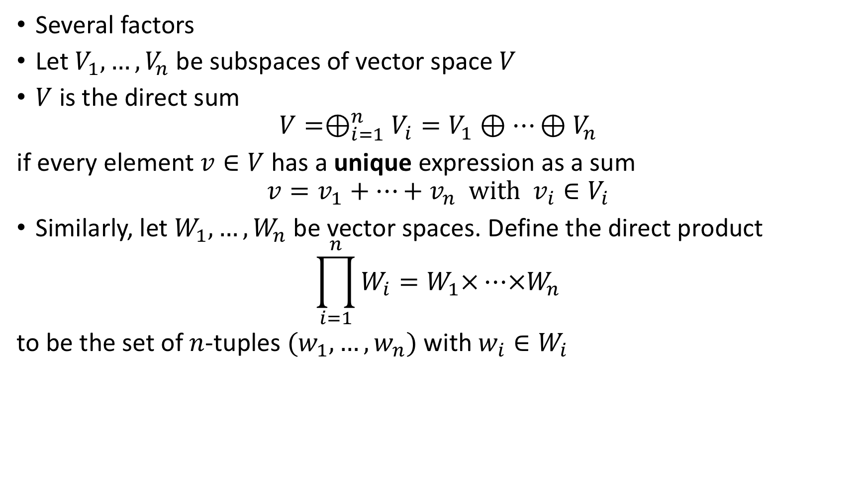
Extensions
Several factors
Let $V_{1},…,V_{n}$ be subspaces of vector space $V$
$V$ is the direct sum
$$V=⊕_{i=1}^{n}V_{i}=V_{1}⊕…⊕V_{n}$$
if every element $v∈V$ has a unique expression as a sum
$$v=v_{1}+…+v_{n} with v_{i}∈V_{i}$$
Similarly, let $W_{1},…,W_{n}$ be vector spaces. Define the direct product
$$\prod_{i=1}^{n}{W_{i}=W_{1}×…×W_{n}}$$
to be the set of $n$-tuples $(w_{1},…,w_{n})$ with $w_{i}∈W_{i}$

Slide 9
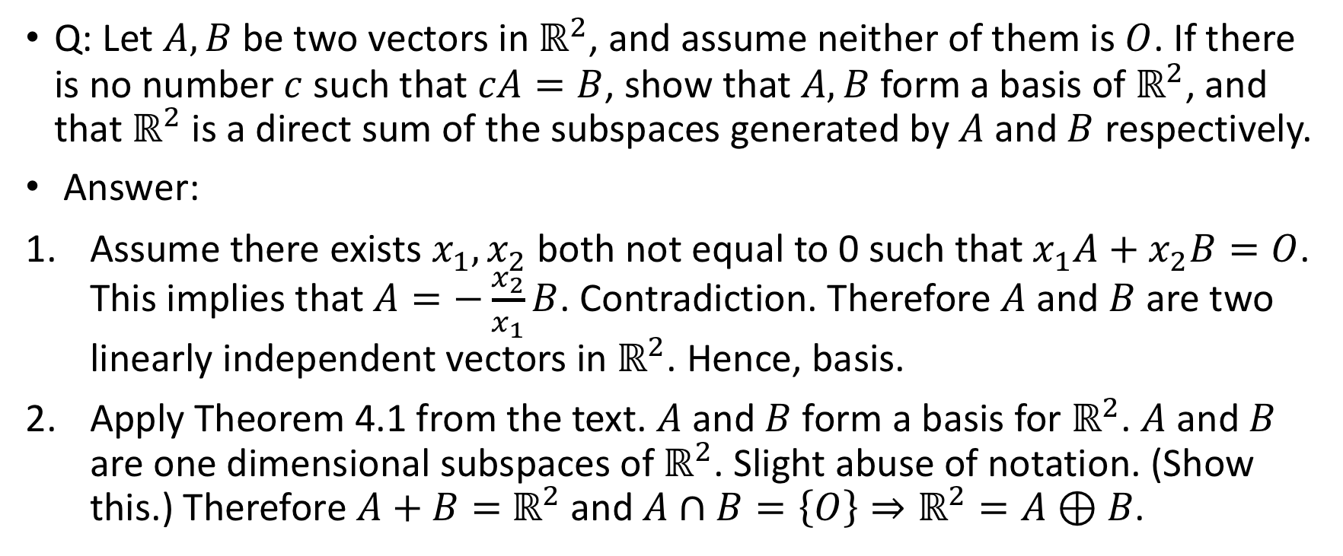
Problems
Q: Let $A, B$ be two vectors in $ℝ^{2}$, and assume neither of them is $O$. If there is no number $c$ such that $cA=B$, show that $A, B$ form a basis of $ℝ^{2}$, and that $ℝ^{2}$ is a direct sum of the subspaces generated by $A$ and $B$ respectively.
Answer:
Assume there exists $x_{1},x_{2}$ both not equal to 0 such that $x_{1}A+x_{2}B=O$. This implies that $A=−\frac{x_{2}}{x_{1}}B$. Contradiction. Therefore $A$ and $B$ are two linearly independent vectors in $ℝ^{2}$. Hence, basis.
Apply Theorem 4.1 from the text. $A$ and $B$ form a basis for $ℝ^{2}$. $A$ and $B$ are one dimensional subspaces of $ℝ^{2}$. Slight abuse of notation. (Show this.) Therefore $A+B=$ $ℝ^{2}$ and $A∩B=\left\{O\right\}⇒ℝ^{2}=A⊕B$.

Slide 10
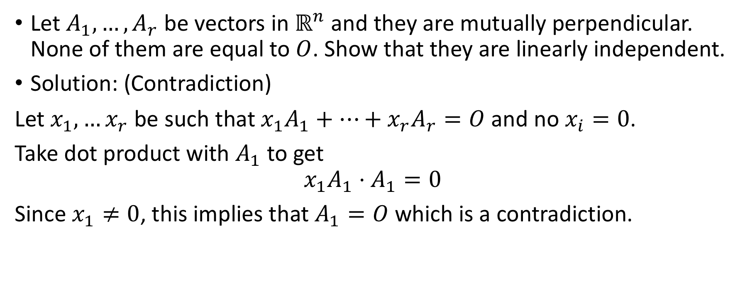
Problem 9
Let $A_{1},…,A_{r}$ be vectors in $ℝ^{n}$ and they are mutually perpendicular. None of them are equal to $O$. Show that they are linearly independent.
Solution: (Contradiction)
Let $x_{1},…x_{r}$ be such that $x_{1}A_{1}+…+x_{r}A_{r}=O$ and no $x_{i}=0$.
Take dot product with $A_{1}$ to get
$$x_{1}A_{1}⋅A_{1}=0$$
Since $x_{1}≠0$, this implies that $A_{1}=O$ which is a contradiction.

Slide 11
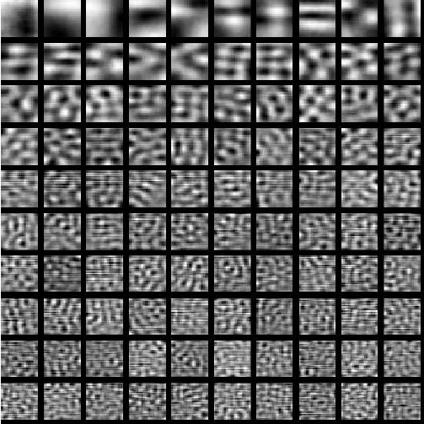
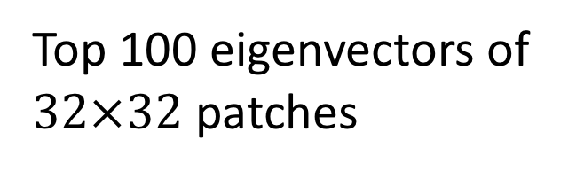
PCA of image patches
Top 100 eigenvectors of
$32×32$ patches

